Slide 1
RELAX:
Presentation Title
Author
Date

Slide 2
System Overview
Employee Portal
Benefits Mgmt
Time Off Tracking
Time & Attendance
Applicant Tracking
Performance Mgmt
Employee Surveys
Wellness Tracking
Workflow Mgmt
Onboarding
Advanced Reporting
InfinityHR is a complete and secure web-based HR Management System that provides online benefits enrollment and other HR functions as needed
Centralizes HR and benefits data into a single system, and provides powerful reporting/exporting capabilities
Allows employees to enroll in and change benefits information on their own, reducing errors and time spent gathering data
Automatically and electronically delivers benefits information to each carrier and payroll provider, eliminating the need to manage multiple forms and manually enter data into multiple systems

Slide 3
Typical Data Flow
1
2
Payroll
System
3
5
4
New Hire Entered
New Hire Data Imported into InfinityHR
New Hire Enrolled
Data Exported to Carriers
Deductions exported to Payroll

Slide 4
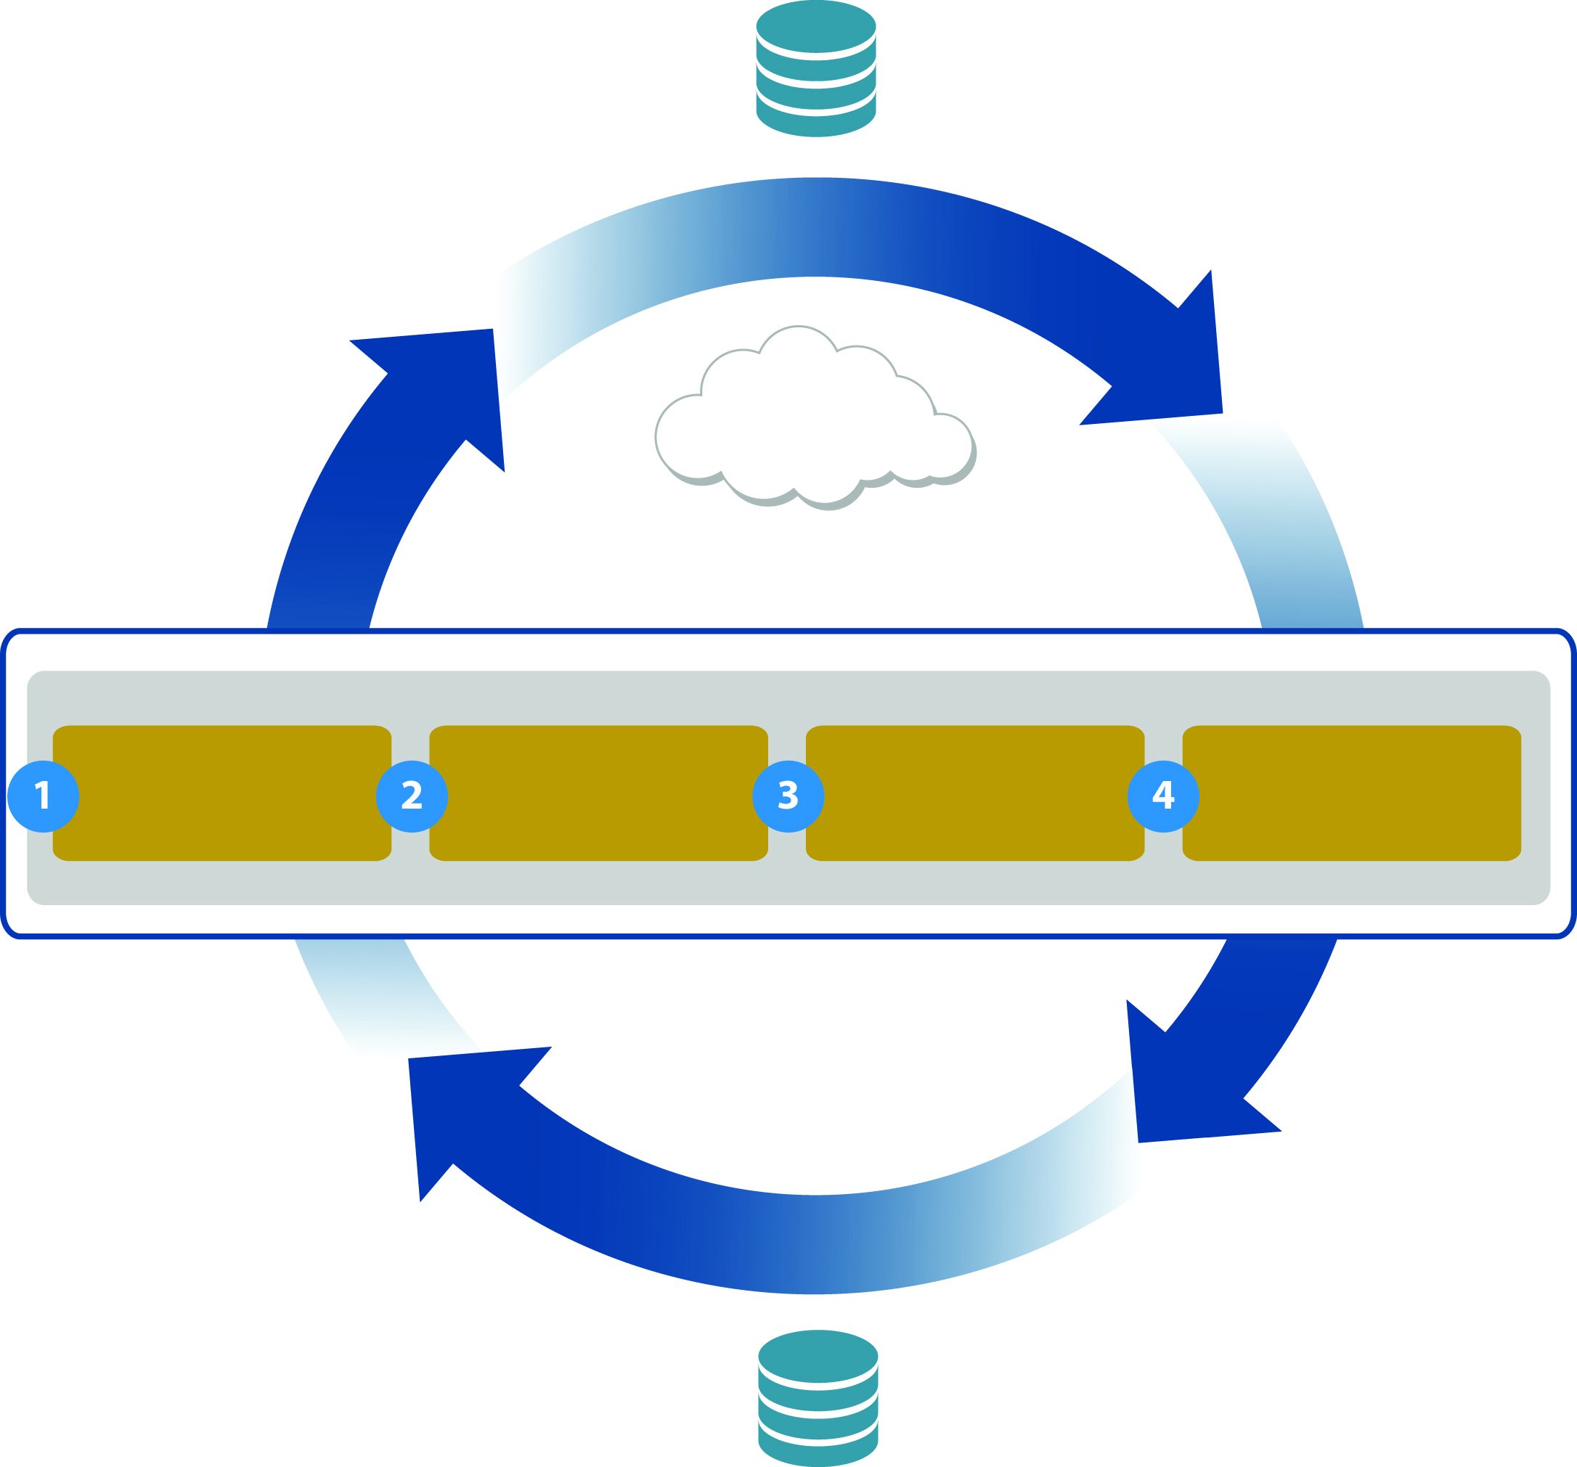
Payroll Sync Overview
InfinityHR
Demographic
Deductions
Employee
Paystubs Imported
into HR
Employee
W2’s
Imported
into HR
State Tax
Bi-Directional Data
Interflow
InfinityHR Payroll Web Service
Federal Tax
Client Payroll Integration Middle Ware – Application Layer
STEPS TO INTEGRATION
Authenticate
To Infinity HR
Service
Perform
Employee
Mapping
Sync By Calling
Employee Sync
Method
Updated Client
Payroll Database
Direct Deposits
Compensation
Pay Stubs
W2
Client Payroll
Database

Slide 5
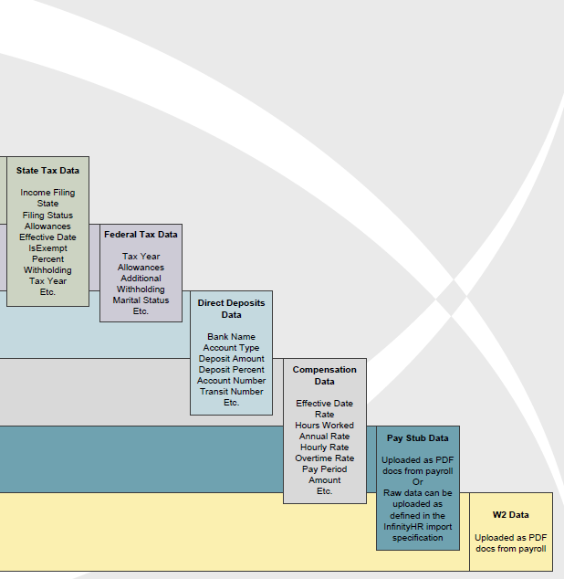
Payroll Sync Data Fields
Demographic
Demographic
Data
First Name
Last Name
DOB
SSN
Address
City
State
Zip
Hire Date
Termination Date
Cost Center 1-5
Email
Phone
Etc.
Deductions
Deduction
Data
Benefit Name
Benefit Type
Effective Date
Employee Cost
Employer Cost
Expiration Date
Package Name
Option Name
Pay Per Employee
Pay Per Employer
Credit Amount
Premium Amount
Etc.
State Tax
State Tax
Data
Income Filing
State
Filing Status
Allowances
Effective Date
Is Exempt
Percent
Withholding
Tax Year
Etc.
Federal Tax
Federal Tax
Tax Year
Allowances
Additional
Withholding
Marital Status
Etc.
Direct Deposits
Direct Deposits
Data
Bank Name
Account Type
Deposit Amount
Deposit Percent
Account Number
Transit Number
Etc.
Compensation
Compensation
Data
Effective Date
Rate
Hours Worked
Annual Rate
Hourly Rate
Overtime Rate
Pay Period
Amount
Etc.
Pay Stubs
Pay Stub Data
Uploaded as PDF doc from Payroll
OR
Raw data can be uploaded as defined in the InfinityHR import specification
W2
W2 Data
Uploaded as PDF doc from Payroll

Slide 6
Payroll Sync Data Fields
Demographic
Demographic
Data
First Name
Last Name
DOB
SSN
Address
City
State
Zip
Hire Date
Termination Date
Cost Center 1-5
Email
Phone
Etc.
Deductions
Deduction
Data
Benefit Name
Benefit Type
Effective Date
Employee Cost
Employer Cost
Expiration Date
Package Name
Option Name
Pay Per Employee
Pay Per Employer
Credit Amount
Premium Amount
Etc.
State Tax
State Tax
Data
Income Filing
State
Filing Status
Allowances
Effective Date
Is Exempt
Percent
Withholding
Tax Year
Etc.
Federal Tax
Federal Tax
Tax Year
Allowances
Additional
Withholding
Marital Status
Etc.
Direct Deposits
Direct Deposits
Data
Bank Name
Account Type
Deposit Amount
Deposit Percent
Account Number
Transit Number
Etc.
Compensation
Compensation
Data
Effective Date
Rate
Hours Worked
Annual Rate
Hourly Rate
Overtime Rate
Pay Period
Amount
Etc.
Pay Stubs
Pay Stub Data
Uploaded as PDF doc from Payroll
OR
Raw data can be uploaded as defined in the InfinityHR import specification
W2
W2 Data
Uploaded as PDF doc from Payroll

Slide 7
Demonstration

Slide 8
Implementation Roles & Responsibilities
InfinityHR Implementation Process 8-12 weeks; timing is dependent on size/scope/complexity, data integrity, and responsiveness
(Illustration of a typical implementation process)
WEEK 1
Kick Off Meeting
Responsibilities Acknowledgment and sign off
Complete import layout template
Complete Benefits Structure Template (Broker Assistance)
Request Current Census from Carriers
Contact Data Interfacing Vendors to initiate transfer process
Status Update
Complete Benefits Rules/Rates Template
Load Employee (Dependent) Data into System
Load Employee (Compensation) Data into System
Configure System
Status Update
WEEK 2-3
WEEK 4-6
Check-in Meeting (if required)
Continue To Configure System
Load Existing Benefit Coverage Data
Audit Deductions against Benefits/Rates
Testing
Build/Deliver Export files to Vendors
Status Update
Release System for Internal Testing
Training
Testing
Ongoing Testing with Vendors
Extract current deductions data from Payroll System
Status Update
WEEK 7-8
WEEK 9
Revisions per Results of Testing
Testing
Review Training
InfinityHR
Client Account
WEEK 10
Review Meeting
Extract Current deductions data from Payroll System
Audit Deductions against Benefits/Rates
System Sign-Off
System Release
InfinityHR & Client Account

Slide 9
Implementation Roles & Responsibilities
InfinityHR Implementation Process 8-12 weeks; timing is dependent on size/scope/complexity, data integrity, and responsiveness
(Illustration of a typical implementation process)
Kick Off Meeting
Responsibilities Acknowledgment and sign off
Complete import layout template
Complete Benefits Structure Template (Broker Assistance)
Request Current Census from Carriers
Contact Data Interfacing Vendors to initiate transfer process
Status Update
WEEK 1
Complete Benefits Rules/Rates Template
Load Employee (Dependent) Data into System
Load Employee (Compensation) Data into System
Configure System
Status Update
WEEK 2-3
Check-in Meeting (if required)
Continue To Configure System
Load Existing Benefit Coverage Data
Audit Deductions against Benefits/Rates
Testing
Build/Deliver Export files to Vendors
Status Update
WEEK 4-6
Release System for Internal Testing
Training
Testing
Ongoing Testing with Vendors
Extract current deductions data from Payroll System
Status Update
WEEK 7-8
WEEK 9
Revisions per Results of Testing
Testing
Review Training
InfinityHR
Client Account
WEEK 10
Review Meeting
Extract Current deductions data from Payroll System
Audit Deductions against Benefits/Rates
System Sign-Off
System Release
InfinityHR & Client Account

Slide 10
Key Differentiators
Full HRIS Functionality
Robust Benefit Management Solution
Dynamic, Flexible and Web-service Enabled Platform
Highly Responsive, Flexible and Committed Service Team
Superior Reporting and Exporting Capabilities:
e.g., Reports: Event Reporting, Data Comparison Utility
e.g., Exports: Self-contained report building (834, fixed length, etc…)
Granular Permissions at Enterprise and Administration Levels

Slide 11
Agenda
Discuss Complete Payroll Client/Prospect base
Best target markets
Discovery process
Discovery document
Key factors
Employee size
Existing HRIS? HRIS priorities?
Client time commitment
Payroll, TLM, benefits
Demonstration Walk-through- Life Cycle

Slide 12
Architecture
Enterprise
Portal
Enterprise
Administrator
Administrative
Portal
Company 1
Company 2
Company 3
Employee
Portal
Employee A
Employee B
Employee C
Employee A
Employee B
Employee C
Employee A
Employee B
Employee C
Employee D
Employee E
Employee F
Employee D
Employee E
Employee F
Employee D
Employee E
Employee F
Granular permissions can be set at all levels

Slide 13
Architecture
Enterprise
Portal
Enterprise
Administrator
Administrative
Portal
Company 1
Company 2
Company 3
Employee
Portal
Employee A
Employee B
Employee C
Employee A
Employee B
Employee C
Employee A
Employee B
Employee C
Employee D
Employee E
Employee F
Employee D
Employee E
Employee F
Employee D
Employee E
Employee F
Granular permissions can be set at all levels

Slide 14
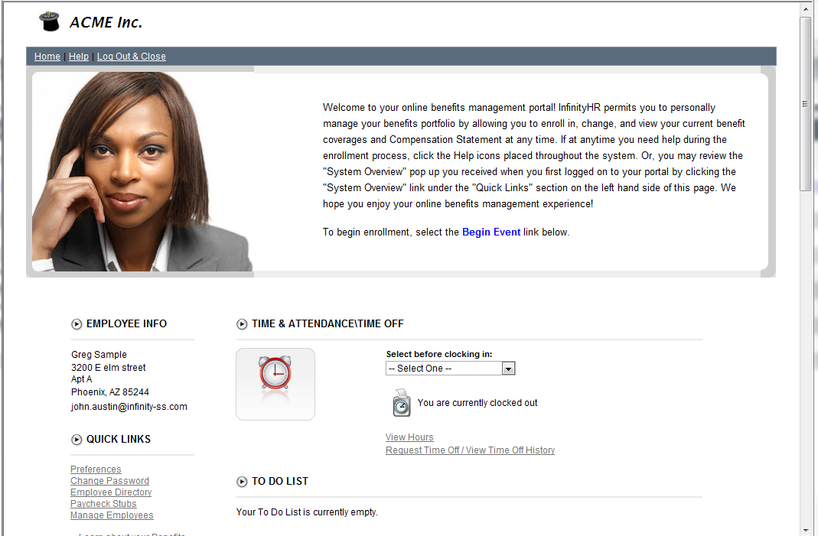
Employee Portal
Employee Portal
Benefits Mgmt
Time Off Tracking
Time & Attendance
Applicant Tracking
Performance Mgmt
Employee Surveys
Wellness Tracking
Workflow Mgmt
Onboarding
Advanced Reporting
Web-based Self-service portal
Allows employees direct access to managing benefits and other HR-related information
Connects employees, managers, administrators, carriers and payroll.
Centralizes all employee activity
Access benefit information
Request Time Off
Record Time
Review Goals and Reviews
Etc….

Slide 15
Benefits Management
Employee Portal
Benefits Mgmt
Time Off Tracking
Time & Attendance
Applicant Tracking
Performance Mgmt
Employee Surveys
Wellness Tracking
Workflow Mgmt
Onboarding
Advanced Reporting
Allows employees to complete new hire, open enrollment and qualified events themselves.
Employees can compare, analyze and check plan costs prior to enrollment.
Employees can print consolidated benefit statements at any time.
Allows for easy approval and management of employee benefits.
Benefits data is automatically exported to your carriers and payroll.
Rules-based eligibility engine.

Slide 16
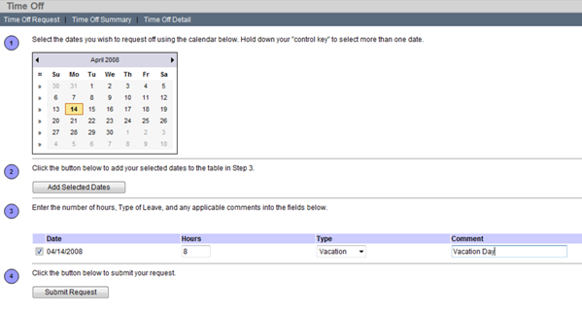
Time Off Tracking
Employee Portal
Benefits Mgmt
Time Off Tracking
Time & Attendance
Applicant Tracking
Performance Mgmt
Employee Surveys
Wellness Tracking
Workflow Mgmt
Onboarding
Advanced Reporting
Rules-based eligibility engine for calculating leave automatically.
Employees can view Time Off balances and request Time Off easily through Employee Portal.
Managers can view employee Time Off balances and history
Managers can approve/deny Time Off requests directly from Employee Portal.
Strong reporting and exporting capabilities.

Slide 17
Time & Attendance
Employee Portal
Benefits Mgmt
Time Off Tracking
Time & Attendance
Applicant Tracking
Performance Mgmt
Employee Surveys
Wellness Tracking
Workflow Mgmt
Onboarding
Advanced Reporting
Allows employees to clock in / clock out or complete timesheet electronically
Time entry can be completed either through Employee Portal or through Physical Time clock
Managers can review and approve time for employees directly through Employee Portal
Strong reporting and exporting capabilities.
Employee Portal
Kiosk / Time Clock
Payroll

Slide 18
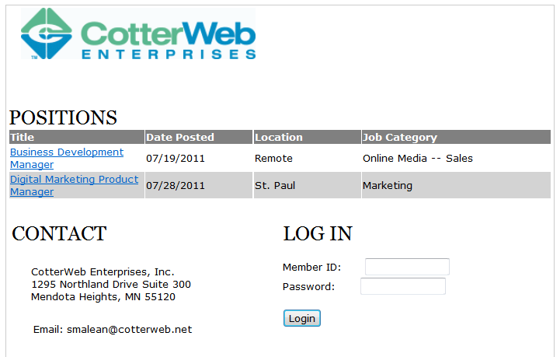
Applicant Tracking
Employee Portal
Benefits Mgmt
Time Off Tracking
Time & Attendance
Applicant Tracking
Performance Mgmt
Employee Surveys
Wellness Tracking
Workflow Mgmt
Onboarding
Advanced Reporting
Applicant Tracking System that can be integrated into existing corporate website.
Job Openings are created/managed directly within system.
Applicants complete electronic applications.
Customized workflows drive applicants through hiring process.
Applicants are converted to employees with one click.

Slide 19
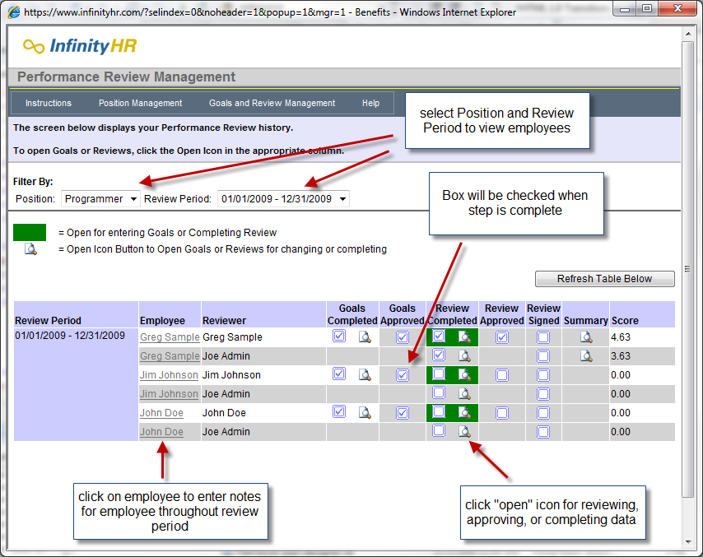
Performance Management
Employee Portal
Benefits Mgmt
Time Off Tracking
Time & Attendance
Applicant Tracking
Performance Mgmt
Employee Surveys
Wellness Tracking
Workflow Mgmt
Onboarding
Advanced Reporting
Aligns corporate strategy with employee activity.
Allows employees to review goals set by management as well as set personal goals.
Employees and Managers complete reviews directly through Employee Portal.
Review scores can be weighted and automatically calculated.
Provides key insights into employee performance and growth.

Slide 20
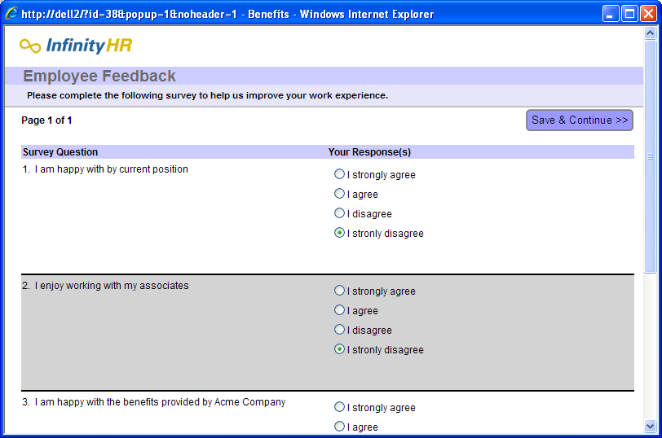
Employee Surveys
Employee Portal
Benefits Mgmt
Time Off Tracking
Time & Attendance
Applicant Tracking
Performance Mgmt
Employee Surveys
Wellness Tracking
Workflow Mgmt
Onboarding
Advanced Reporting
Provides key insights into Employee sentiments and morale.
Tailor one of the many templates in the Survey Library, or design an entirely new survey with a professional look and feel.
Track in real time which employees have completed the survey, and send reminders to those who haven’t.
Standardized professional survey reports include summary reports, graphical reports, and detail reports.

Slide 21
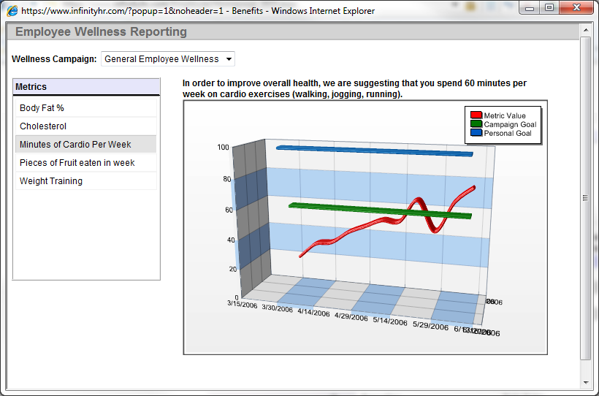
Wellness Tracking
Employee Portal
Benefits Mgmt
Time Off Tracking
Time & Attendance
Applicant Tracking
Performance Mgmt
Employee Surveys
Wellness Tracking
Workflow Mgmt
Onboarding
Advanced Reporting
Provides the ability to extend employee wellness initiatives to employees.
Employee can easily track progress against Wellness Metrics.
Import data from external sources.
Create contests and identify employees or employee groups who succeed within wellness campaign.

Slide 22
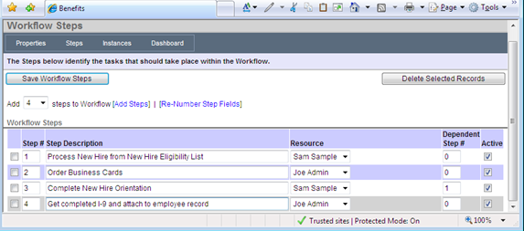
Workflow Management
Employee Portal
Benefits Mgmt
Time Off Tracking
Time & Attendance
Applicant Tracking
Performance Mgmt
Employee Surveys
Wellness Tracking
Workflow Mgmt
Onboarding
Advanced Reporting
Automates the tracking of key processes within an organization.
Ensures that processes are consistent, complete.
Provides email notifications to resources.
Provides powerful reporting for viewing outstanding workflows.

Slide 23
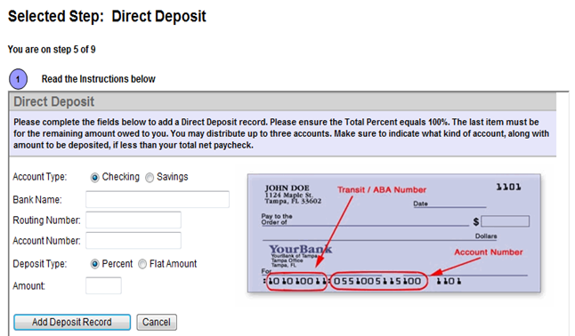
Onboarding
Employee Portal
Benefits Mgmt
Time Off Tracking
Time & Attendance
Applicant Tracking
Performance Mgmt
Employee Surveys
Wellness Tracking
Workflow Mgmt
Onboarding
Advanced Reporting
Allows new hires to complete customized onboarding steps
e.g., I-9, direct deposit, orientation video, uploading agreements, etc…
Ensures timely completion of steps
Full self-service process
Enabled for video and document review

Slide 24
Advanced Reporting
Employee Portal
Benefits Mgmt
Time Off Tracking
Time & Attendance
Applicant Tracking
Performance Mgmt
Employee Surveys
Wellness Tracking
Workflow Mgmt
Onboarding
Advanced Reporting
Standard Reporting
Ad-hoc Exporting
Hundreds of reports available
Standard Pre-built reports
One-click access
Exportable to MSOffice Applications
Create exports of all data within InfinityHR
Export to a multitude of formats
Fine-level formatting capabilities
Scheduling
Full History of all exports

Slide 25
System Overview
Employee Portal
Benefits Mgmt
Time Off Tracking
Time & Attendance
Applicant Tracking
Performance Mgmt
Employee Surveys
Wellness Tracking
Workflow Mgmt
Onboarding
Advanced Reporting
InfinityHR is a complete and secure web-based HR Management System that provides online benefits enrollment and other HR functions as needed
Centralizes HR and benefits data into a single system, and provides powerful reporting/exporting capabilities
Allows employees to enroll in and change benefits information on their own, reducing errors and time spent gathering data
Automatically and electronically delivers benefits information to each carrier and payroll provider, eliminating the need to manage multiple forms and manually enter data into multiple systems

Slide 26
Implementation Overview
Implementation is designed to be completed in six weeks.
For Implementation to be completed on time, it is important for Account to get required data back to InfinityHR by end of Week 1.
The client is responsible for populating/completing implementation templates; InfinityHR is available for support
Third Party exports can sometimes extend beyond six weeks due to responsiveness of third party. This is not a determining factor in implementation being closed.
At the end of the Implementation, your account will be transitioned to an ongoing Account Manager who will provide you with ongoing support.
Billing may begin before Implementation is closed – see your Agreement for more details.
Confidential

Slide 27
HRIS Priorities
What are your HRIS priorities?
Employee self-service?
Online enrollment?
Applicant tracking?
Performance management?
Time & Attendance?
Time off?
Workflows?
What is your HRIS selection process?
Timing, budget, decision makes, etc…
What do you want to accomplish in today’s demo?
Confidential

Slide 28
Demo Agenda
System Overview
Features
Data flow
Applicant Tracking
Applicant’s perspective
Employee Portal
Administration Portal

